Slide 1
Training Frequency, Weekly Volume, and Muscle and Strength Gains
DATA200 · APPLIED STATISTICAL ANALYSIS
Open resistance-training data (Pelland et al., 2026)
Navaraj Thapa · Abdul Sheikh
Shishir Sharma · Prasanna Shakya
October 2026
Real, published data. Each row is a group average, so results describe groups and show association, not cause.
Notes:
Suggested speaker: Navaraj. [0:00 to 0:20] Introduce the group and the title question: do more weekly training sessions, or more weekly sets, go with bigger gains in muscle size and strength? Say at once that the data are real and published, from a meta-analysis (Pelland et al., 2026), so the numbers are group averages from studies, not individual lifters.

Slide 2
Introduction
2
Gym advice is easy to repeat and hard to check. How often to train a muscle and how many sets to do are easy to change.
70
published studies in the file
We ask how weekly frequency and weekly volume relate to muscle growth and strength gain.
229
group rows analyzed after cleaning
Data: the open dataset behind a published meta-regression (Pelland et al., 2026).
2
Group averages: association only, no causal claims.
outcomes: muscle size and strength
Notes:
Suggested speaker: Navaraj. [0:20 to 1:00] Start from the everyday gym questions: how often to train a muscle and how many hard sets to do per week. Both are easy to change, so people argue about them. Our data are real: the open dataset behind a published meta-regression, 70 studies, 229 group-outcome rows after cleaning. Be clear that each row is a group average, so we describe groups and show association, not cause. The file has no usable protein variable, so our second predictor is weekly volume.

Slide 3
Problem Statement
3
Training frequency
Weekly volume
Muscle growth
Strength gain
→
Adjusted for weeks, age, % male and training status. Two-sided α = .05.
RQ | Research question | Null hypothesis (H₀)
1 | Is frequency related to muscle growth, after volume? | Frequency has no association with hypertrophy.
2 | Is weekly volume related to muscle growth? | Volume has no association with hypertrophy.
3 | Are frequency and volume related to strength gain? | Neither is associated with strength gain.
4 | Does the frequency effect depend on volume? | There is no frequency × volume interaction.
Notes:
Suggested speaker: Navaraj. [1:00 to 1:40] State the problem in one sentence, then the four research questions. Each has a null hypothesis we wrote before any test (alpha = .05, two-sided). We keep frequency and volume in the same model because they are tangled: groups that train more often also tend to do more sets.

Slide 4
Literature Review
4
Training frequency | Schoenfeld et al. (2016) | With weekly volume equal, training a muscle twice a week beat once a week. Twice vs. three times could not be separated.
Frequency and volume | Pelland et al. (2026) | 67 studies, 2,058 people. Gains rose with volume. Once volume was counted, frequency mattered little for muscle; strength kept rising with frequency.
Protein (not in our file) | Morton et al. (2018); Tagawa et al. (2021) | Benefit levels off at about 1.3 to 1.6 g/kg/day. Our file has no numeric protein variable.
What we expect: volume matters for muscle size, and frequency matters for strength. We keep both in one model.
Notes:
Suggested speaker: Abdul. [1:40 to 2:30] Schoenfeld et al. (2016): with volume equal, training a muscle twice a week beat once a week, but twice versus three times could not be separated. Pelland et al. (2026): 67 studies and 2,058 people; once volume was counted, frequency mattered little for muscle, while strength kept rising with frequency. Morton (2018) and Tagawa (2021) on protein explain why we wanted protein, but our file has no numeric protein column. So we expect volume to matter for muscle size and frequency for strength. Meta-analyses report averages across groups, not what happens to one person.

Slide 5
Dataset Selection
5
710
70
168
229
2
rows in the raw file
studies
training groups
rows analyzed
outcomes
Open data of Pelland et al. (2026), on the Open Science Framework (osf.io/6z3xu), saved unedited.
Outcomes
One row = one outcome in one training group: a group average, not a person.
Muscle size (hypertrophy), % change
Strength (1RM and similar), % change
Frequency = sessions per muscle per week. Volume = hard sets per muscle per week.
No numeric protein column in the file.
Real data with a documented source, but group averages: results describe groups, not people.
Notes:
Suggested speaker: Abdul. [2:30 to 3:10] The data come from the Open Science Framework project of Pelland et al. (osf.io/6z3xu). We saved the Excel file exactly as downloaded and never edit it; we checked it is identical to the file in the OSF download. One row is one outcome in one training group: a group average, not a person. 710 rows, 70 studies, 168 groups. The paper's main models used 67 studies, so our numbers will not match the paper's exactly. No numeric protein variable, so weekly volume is our second predictor.

Slide 6
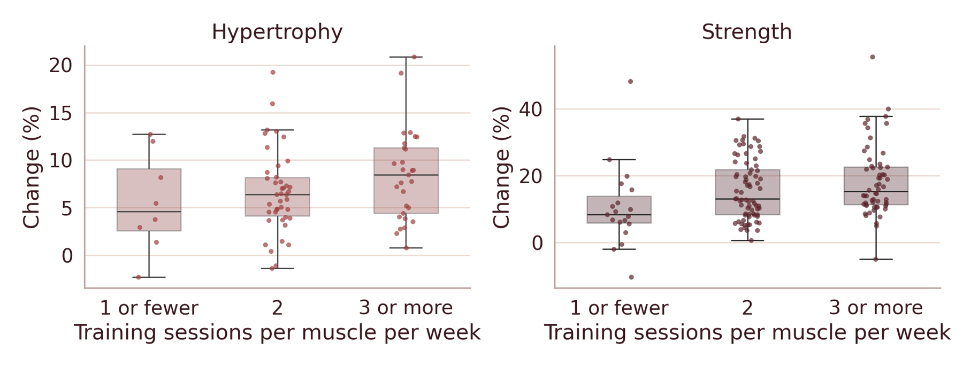
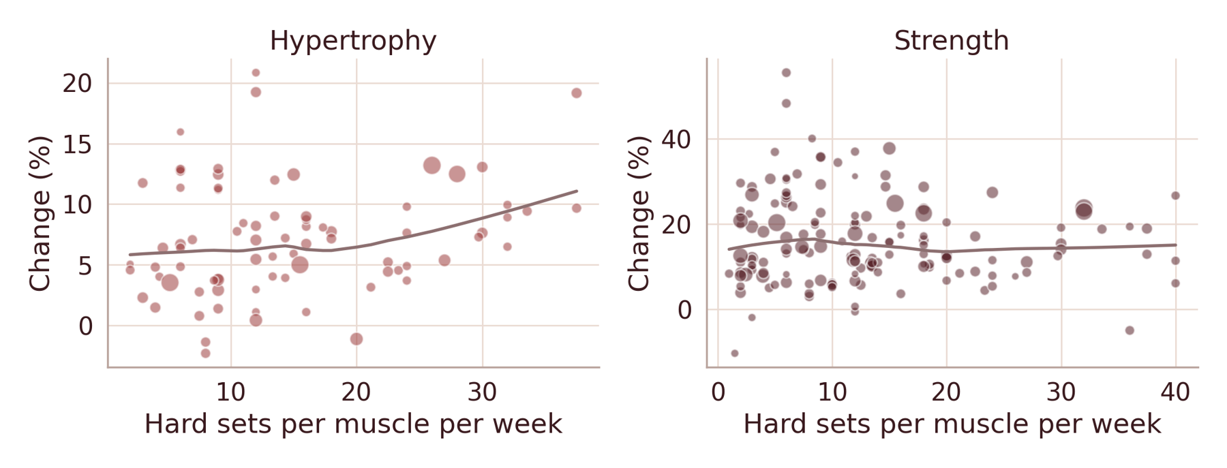
Exploratory Data Analysis
6
Figure 1. Change by sessions per muscle per week.
Figure 2. Change by weekly hard sets, with a lowess line.
r = .27 / .21
r = .21 / −.09
r = −.23 / −.38
frequency with hypertrophy / strength
weekly sets with hypertrophy / strength
trained vs. untrained groups, with gains
Frequency goes with both gains. Volume goes with muscle size only. Beginners gain the most.
Notes:
Suggested speaker: Abdul. [3:10 to 4:00] Left: both gains are higher at 3 or more sessions per week. Right: hypertrophy rises with weekly sets above about 20, while strength looks flat. Raw correlations: frequency goes with both outcomes (r = .27 and .21), weekly sets only with hypertrophy (r = .21 and -.09), and trained groups gain less (beginners improve fastest). After Holm's adjustment only frequency with strength and training status with strength stay below .05. The lowest frequency level has only 8 hypertrophy groups and 19 strength groups.

Slide 7
Data Cleaning Process
7
What we changed
1
2
3
4
Percent change outcome
→
Removed 60 control rows
→
Averaged within group
→
Dropped 4 rows
missing sex: 229 left
(post − pre) / pre
no-training groups
233 group-outcome rows
What we checked
0
0
8
5
duplicate rows
impossible values
rows missing % male
outliers flagged, kept
Sanity check: control groups changed little (−0.3%, −2.7%); training groups improved (+7.0%, +15.8%).
Notes:
Suggested speaker: Shishir. [4:00 to 4:40] Outcome: percent change from each group's own starting average, so different tests are comparable. No duplicates, no impossible values, 8 rows missing percent male. We removed 60 no-training control rows from the models, and they work as a sanity check: controls changed about -0.3% (muscle) and -2.7% (strength), training groups +7.0% and +15.8%. We averaged measures within each group and outcome to avoid counting the same people several times (233 rows), then dropped 4 rows with no sex information: 229 rows, 79 hypertrophy and 150 strength. Five unusual groups were flagged and kept; we test them later.

Slide 8
Modeling: Why These Models
8
Model 1
Model 2
Model 3
Frequency + covariates
→
Model 1 + weekly sets
→
Model 2 + frequency × sets
Frequency on its own
Frequency after volume (RQ1 to RQ3)
Does frequency depend on volume? (RQ4)
Weighted by group size; standard errors clustered by study, because groups in one study share a lab and population.
ANOVA and ANCOVA are cross-checks. A mixed model is a robustness check.
Validation holds out whole studies. Bootstrap resamples whole studies.
Notes:
Suggested speaker: Shishir. [4:40 to 5:30] Why these models. Regression adjusts for weeks, age, percent male and training status and gives effect sizes with intervals. Model 1: frequency. Model 2: add weekly sets. Model 3: add the interaction for RQ4. We also tried a curved volume term. Groups are weighted by size, and standard errors are clustered by study because groups in the same study share a lab and a population: the intraclass correlation is .55 and .81. ANOVA and ANCOVA are cross-checks; a mixed model is a robustness check. Be open that the validation splits whole studies.

Slide 9
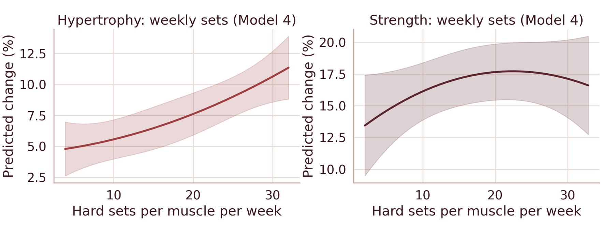
Results: Muscle Growth
9
+2.39 pts
per 10 extra weekly sets, 95% CI [1.11, 3.68], p = .001
+0.69 pts
per extra session, 95% CI [−0.15, 1.53], p = .104
Figure 3. Predicted change by weekly sets (Model 4). Left: muscle size. Right: strength.
Frequency alone: +1.23 per session (p = .006). Add volume and it shrinks to +0.69: much of it was a volume effect.
Notes:
Suggested speaker: Prasanna. [5:30 to 6:25] Muscle growth. Frequency alone looks useful: +1.23 points per session. Once weekly sets enter the model, frequency shrinks to +0.69 and is not significant, while volume is +2.39 points per 10 extra sets (95% CI 1.11 to 3.68, p = .001). A lot of the frequency effect was really volume. We reject H0 for RQ2 but not for RQ1. Trained groups gain about 3.8 points less than untrained ones. Right: predicted change rises with weekly sets for hypertrophy and is flat for strength.

Slide 10
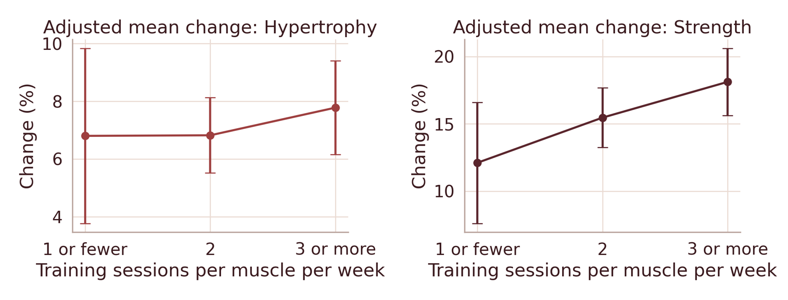
Results: Strength Gain
10
+1.98 pts
per extra session, 95% CI [0.25, 3.70], p = .025
+0.81 pts
per 10 extra sets, 95% CI [−1.11, 2.73], p = .402
Figure 4. Adjusted mean change by sessions per muscle per week (ANCOVA).
Frequency matters for strength after volume; volume does not. 3 or more sessions beat 1 or fewer by 7.7 points (Tukey p = .011). Association, not causation.
Notes:
Suggested speaker: Prasanna. [6:25 to 7:05] Strength. After accounting for volume, each extra weekly session goes with about +1.98 points of strength gain (95% CI 0.25 to 3.70, p = .025). Weekly sets does not matter for strength (+0.81, p = .402). ANOVA agrees in direction: 3 or more sessions beat 1 or fewer by 7.7 points (Tukey p = .011), though that group is small. Adjusted means 12.1%, 15.5%, 18.1%. Association, not causation.

Slide 11
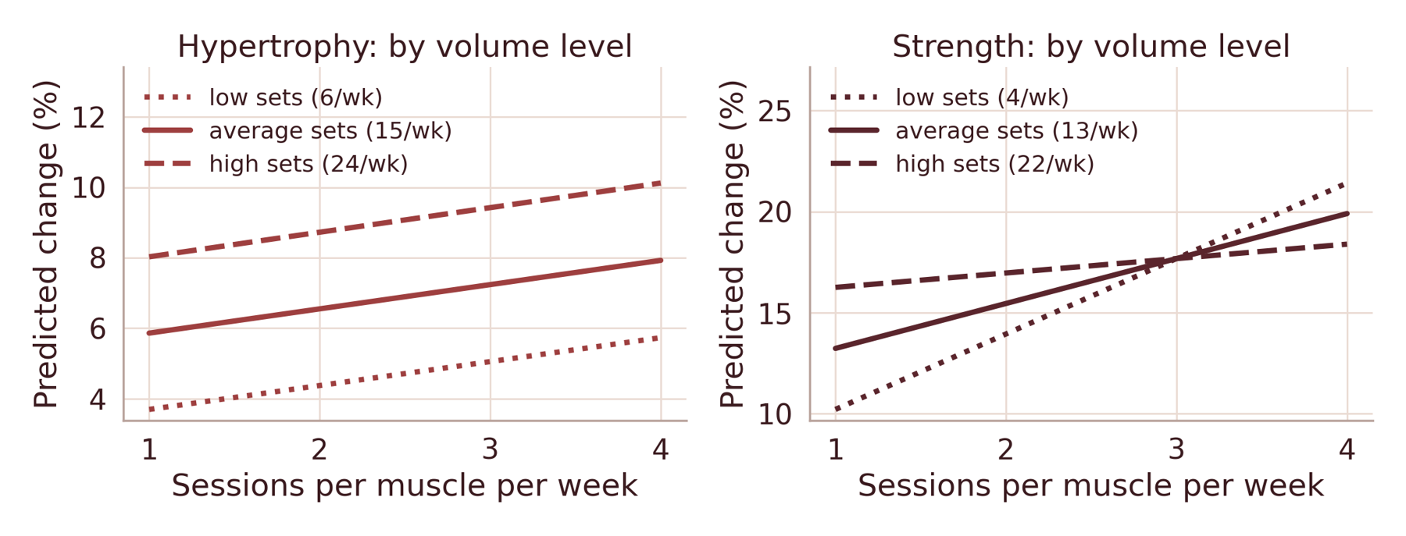
Results: Frequency × Volume
11
p = .986
interaction, muscle size
−1.60, p = .040
interaction, strength: +3.7 / +2.2 / +0.7 per session at low / average / high volume
Figure 5. Predicted change at low, average and high weekly volume (Model 3).
Muscle size: no interaction. Strength: suggestive only. The study-level bootstrap interval [−3.36, 0.02] reaches zero, and we tested four hypotheses.
Notes:
Suggested speaker: Prasanna. [7:05 to 7:35] For muscle size the lines are parallel: no interaction (p = .986). For strength the interaction is negative (-1.60, p = .040): an extra session adds about 3.7 points at low volume, 2.2 at average and 0.7 at high volume. Be open that this is suggestive: the study-level bootstrap interval (-3.36 to 0.02) just reaches zero and we tested four hypotheses.

Slide 12
Evaluation Metrics
12
R² .283 / .205
CV R² −.15 / .03
RMSE 4.9 / 10.0
Model 2 on all groups (muscle / strength)
held-out studies, Model 2 (muscle / strength)
typical miss in points for a new study
Skewed residuals
Study clustering
Robust
Shapiro–Wilk p = .006 / .003, so we use clustered errors and a bootstrap.
Intraclass correlation .55 / .81: groups are not independent.
2,000 study resamples and five setups agree.
The models describe association but predict a new study poorly: for muscle size, held-out R² is below the plain average; for strength it is about .05.
Notes:
Suggested speaker: Prasanna. [7:35 to 8:25 on the slide, then about 75 seconds of live Streamlit demo] Evaluation metrics. R-squared of Model 2 is .283 for muscle and .205 for strength on all groups. When whole studies are held out, cross-validated R-squared is -.15 for muscle (worse than guessing the average) and .03 for strength (.05 for Models 1 and 3); typical miss 4.9 and 10.0 points. So the models describe association but predict a new study poorly. Assumptions: residuals are skewed, so we use clustered errors and a study-level bootstrap (2,000 resamples), and five different setups give the same conclusions. Then say: now we show how this works in the Streamlit app, and switch to the live demo.

Slide 13
Conclusion
13
1
More weekly sets go with more muscle growth: +2.4 points per 10 sets.
2
More weekly sessions go with more strength gain: +2.0 points per session.
3
Models predict new studies poorly: most variation is between studies.
Limitations
Next step
Group averages, association only.
Individual-level data.
Few low-frequency groups.
Measured protein intake.
No protein variable.
Thank you. Questions?
Notes:
Suggested speaker: Navaraj, then all four for questions. [9:30 to 10:00] Back from the Streamlit demo. Three takeaways, then limits and the next step. Close by saying the project shows a complete, honest workflow on real published data, that the data are group averages, and that individual-level data with measured protein is the natural next step. Thank the audience and invite questions.

Slide 14
References
14
Efron, B., & Tibshirani, R. J. (1993). An introduction to the bootstrap. Chapman & Hall.
Morton, R. W., Murphy, K. T., McKellar, S. R., Schoenfeld, B. J., Henselmans, M., Helms, E., Aragon, A. A., Devries, M. C., Banfield, L., Krieger, J. W., & Phillips, S. M. (2018). A systematic review, meta-analysis and meta-regression of the effect of protein supplementation on resistance training-induced gains in muscle mass and strength in healthy adults. British Journal of Sports Medicine, 52(6), 376–384. https://doi.org/10.1136/bjsports-2017-097608
Pelland, J. C., Remmert, J. F., Robinson, Z. P., Hinson, S. R., & Zourdos, M. C. (2025). Extracted data, analysis scripts, and supplementary materials for “The resistance training dose response” [Data set]. Open Science Framework. https://osf.io/6z3xu
Pelland, J. C., Remmert, J. F., Robinson, Z. P., Hinson, S. R., & Zourdos, M. C. (2026). The resistance training dose response: Meta-regressions exploring the effects of weekly volume and frequency on muscle hypertrophy and strength gains. Sports Medicine, 56(2), 481–505. https://doi.org/10.1007/s40279-025-02344-w
Schoenfeld, B. J., Ogborn, D., & Krieger, J. W. (2016). Effects of resistance training frequency on measures of muscle hypertrophy: A systematic review and meta-analysis. Sports Medicine, 46(11), 1689–1697. https://doi.org/10.1007/s40279-016-0543-8
Tagawa, R., Watanabe, D., Ito, K., Ueda, K., Nakayama, K., Sanbongi, C., & Miyachi, M. (2021). Dose–response relationship between protein intake and muscle mass increase: A systematic review and meta-analysis of randomized controlled trials. Nutrition Reviews, 79(1), 66–75. https://doi.org/10.1093/nutrit/nuaa104
Notes:
Backup slide. Only open it if someone asks where a source comes from. Full APA references are also in the report.

